Slide 1
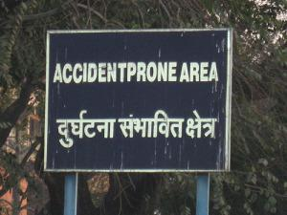
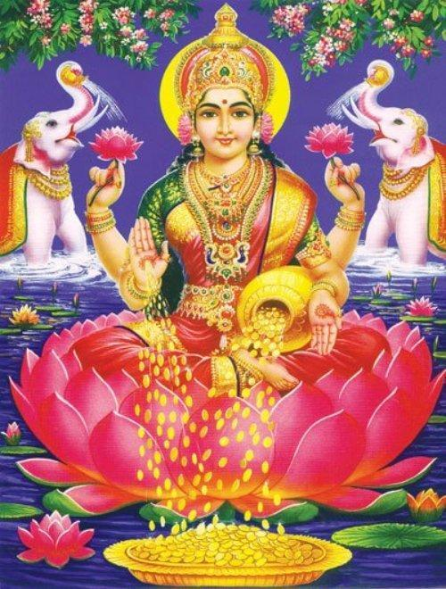
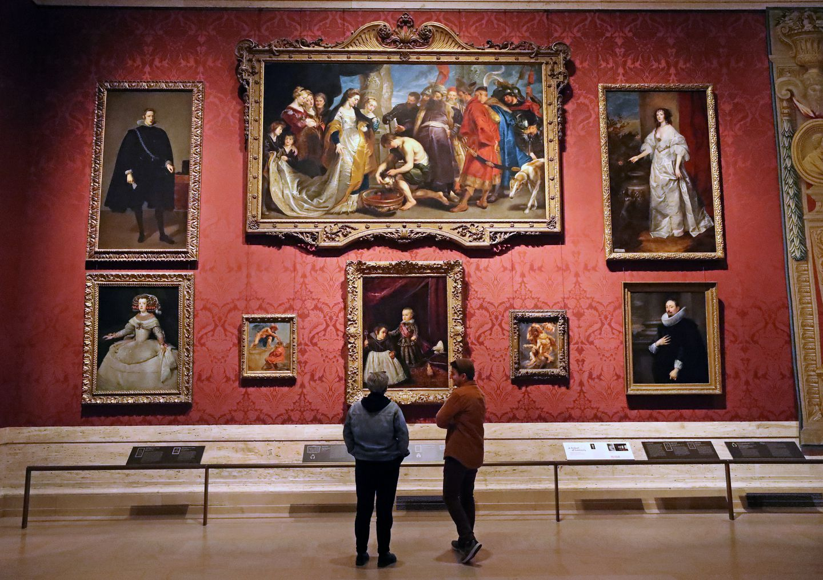

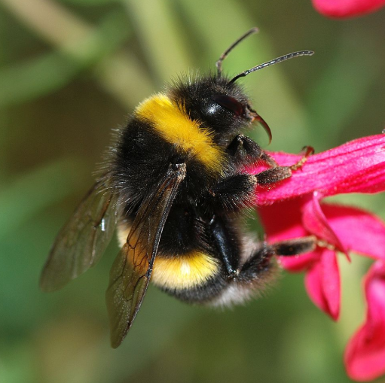
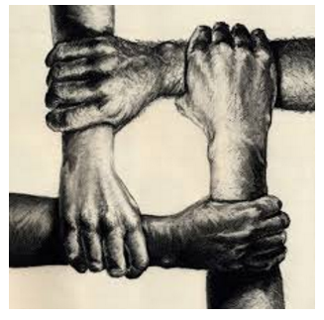
Puzzle #1
7/11
5/14
3/10
5/11
6/8
5/6

Slide 2
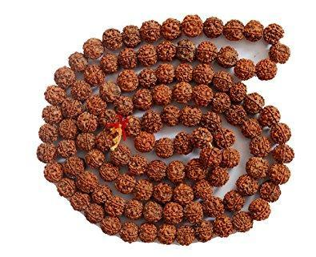

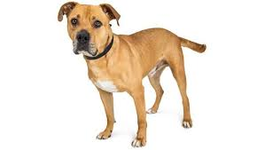
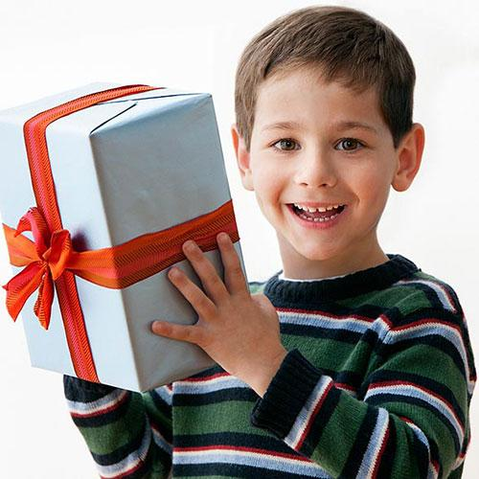
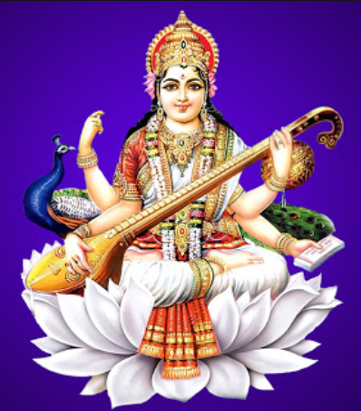
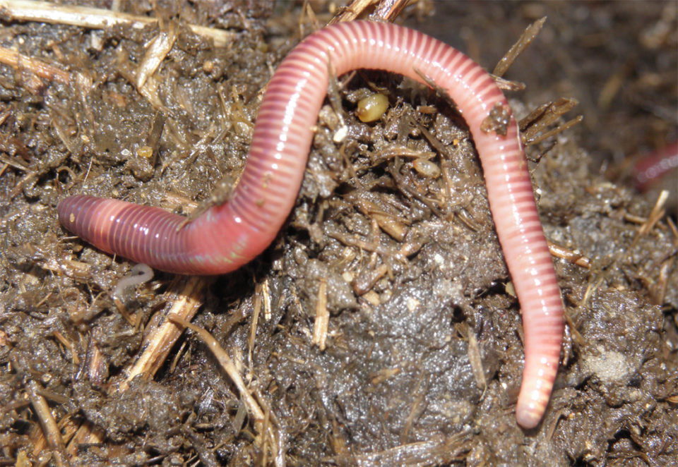
Puzzle #2
5/11
2/9
1/11
2/8
7/8
6/7

Slide 3
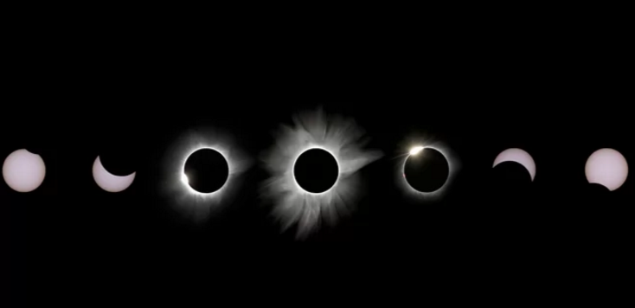

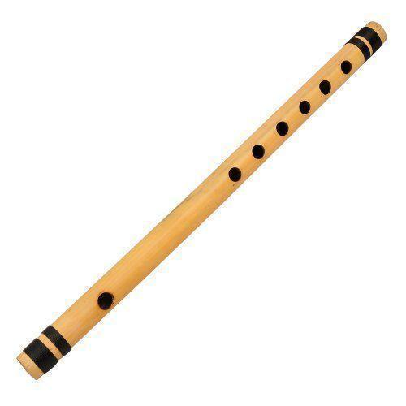
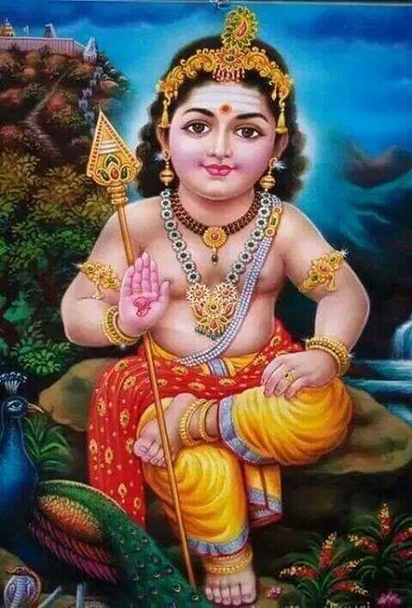


Puzzle #3
1/12
6/10
6/11
9/20
6/12
8/9

Slide 4
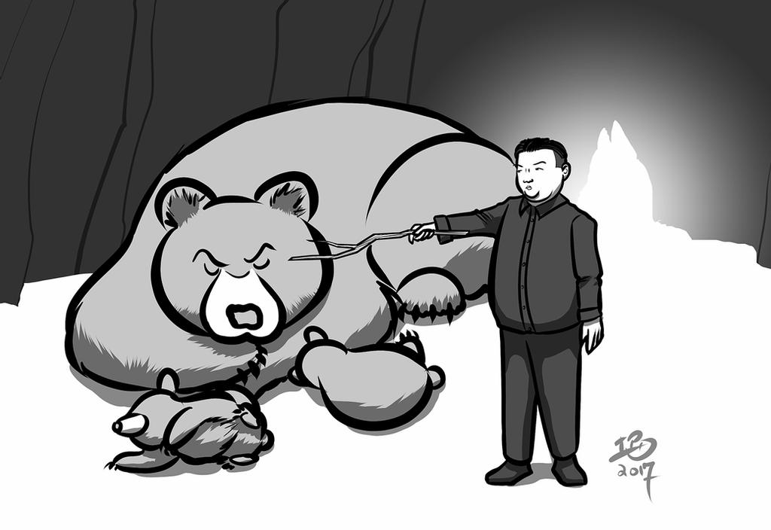
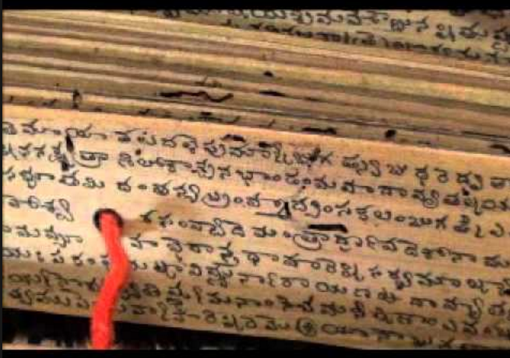
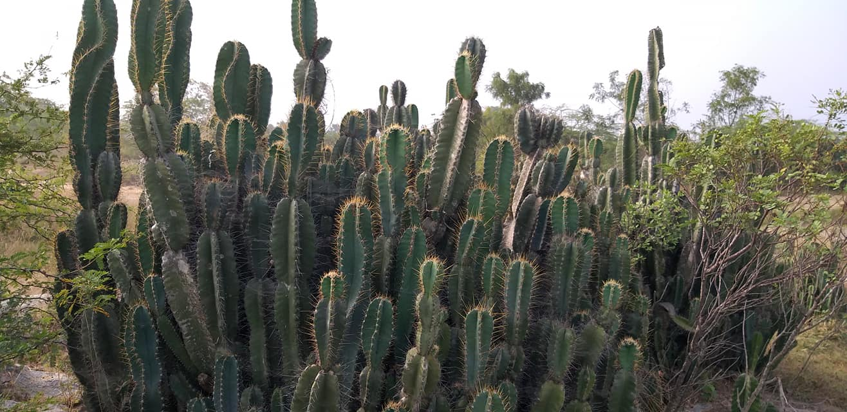
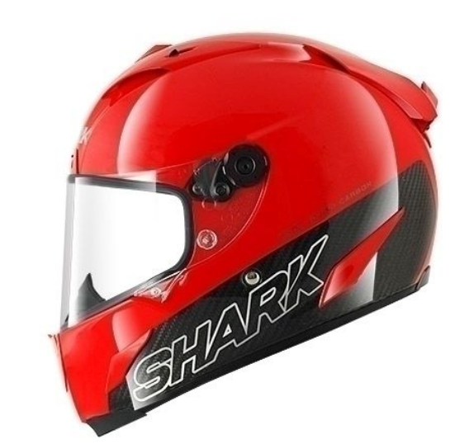

Puzzle #4
1/12
10/12
8/14
4/12
10/11
8/9

Slide 5
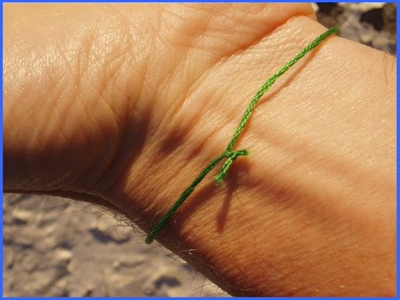



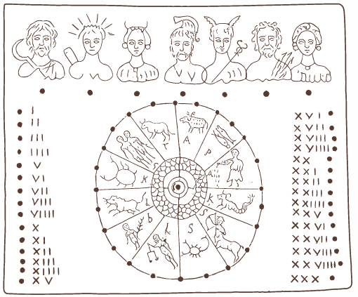
Puzzle #5
5/10
9/13
8/14
8/10
10/12
12/13

Slide 6
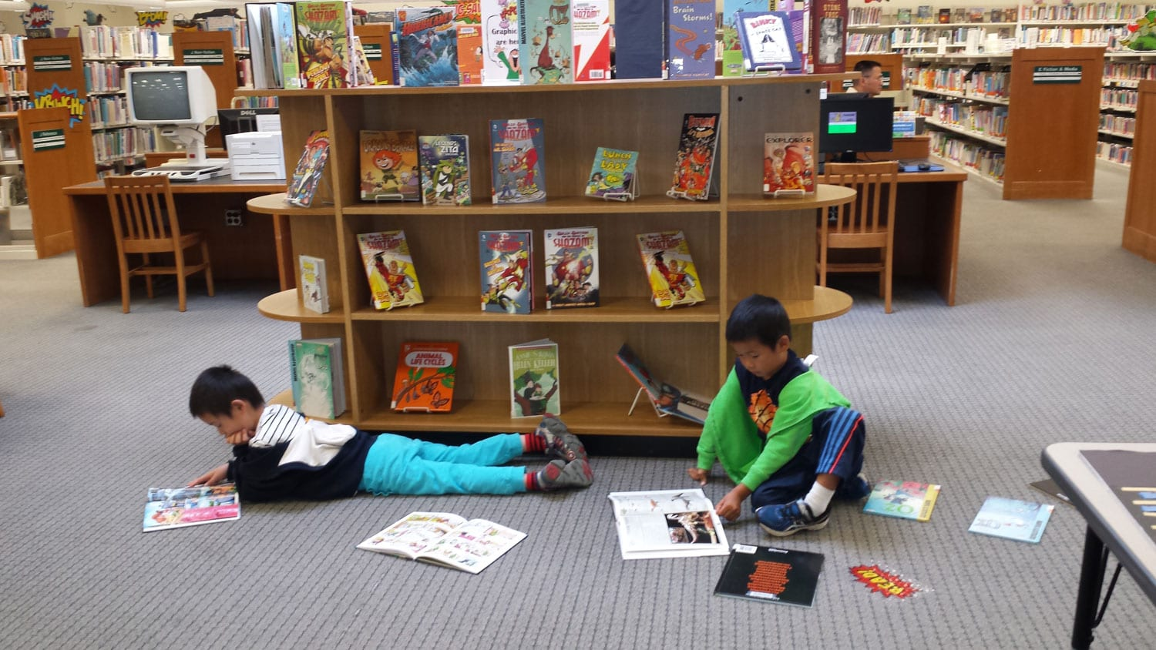
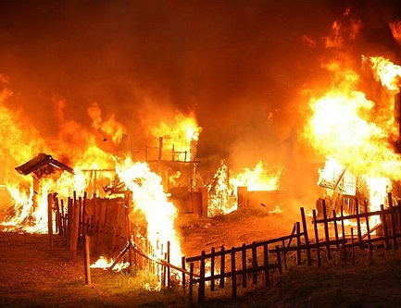
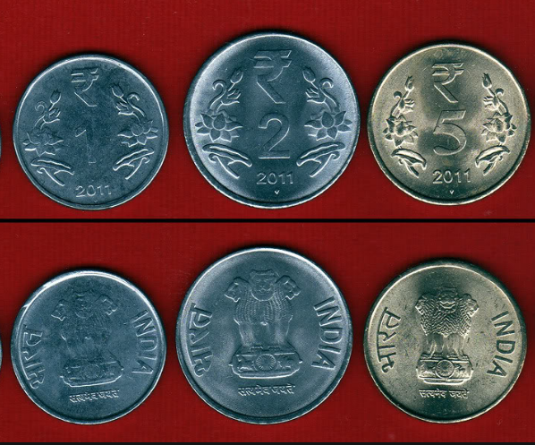
Puzzle #6
2/4
6/10
1/10
2/7
3/8
8/9

Slide 7
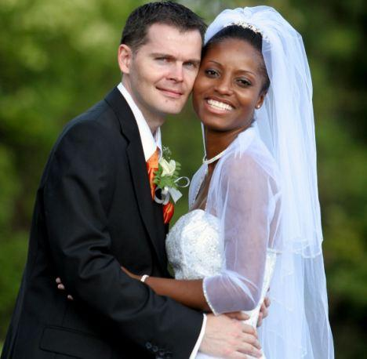
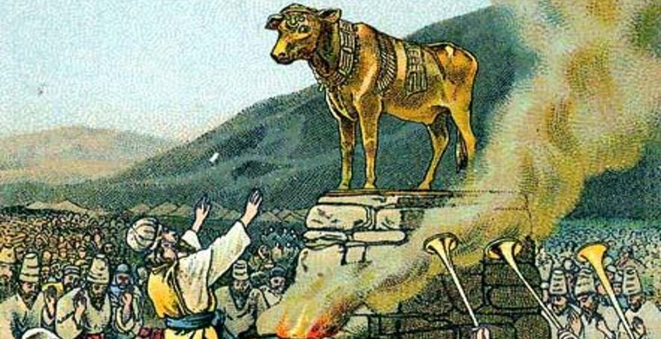
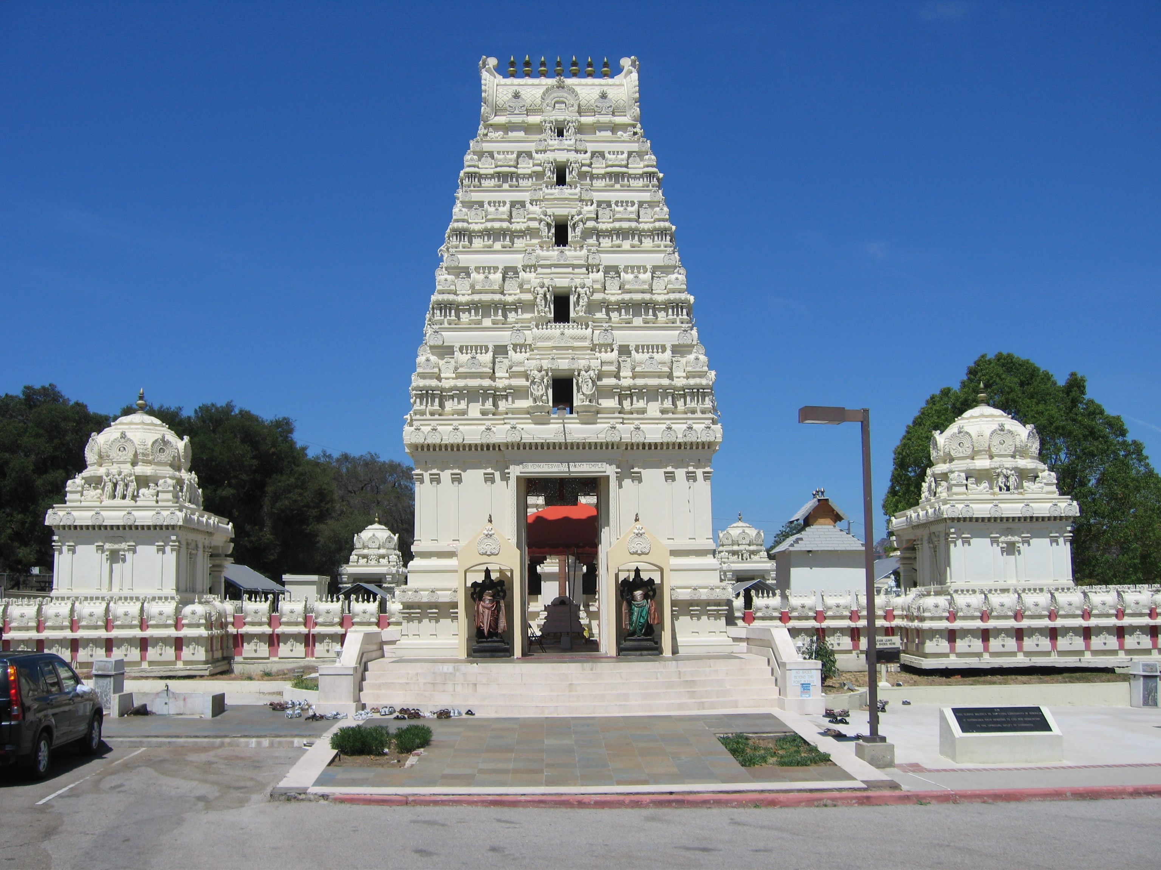
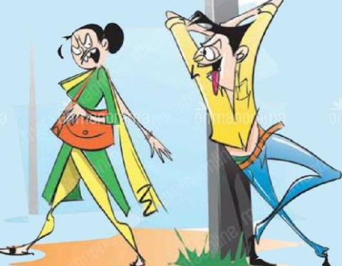
Puzzle #7
5/11
3/12
3/11
6/8
3/9
7/8

Slide 8

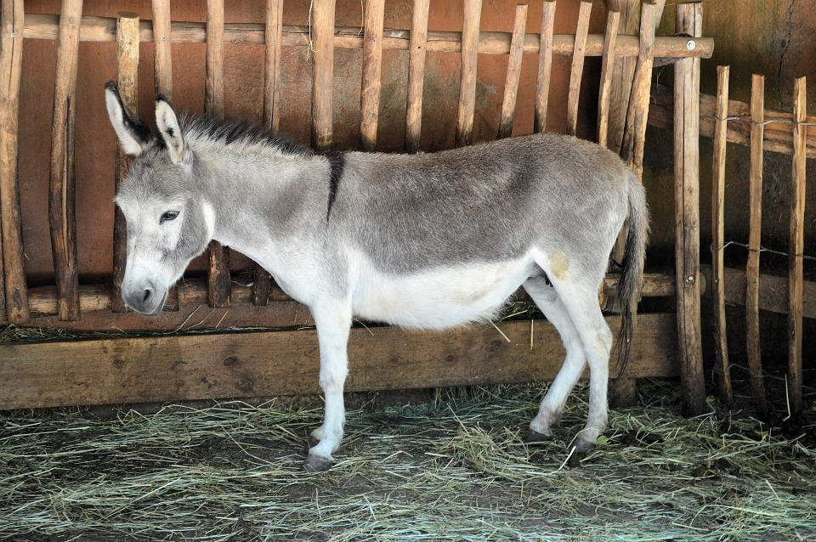

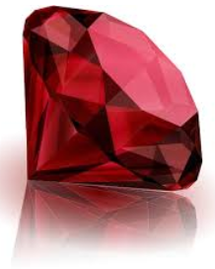

Puzzle #8
1/10
10/12
1/10
6/8
3/9
8/9

Slide 9
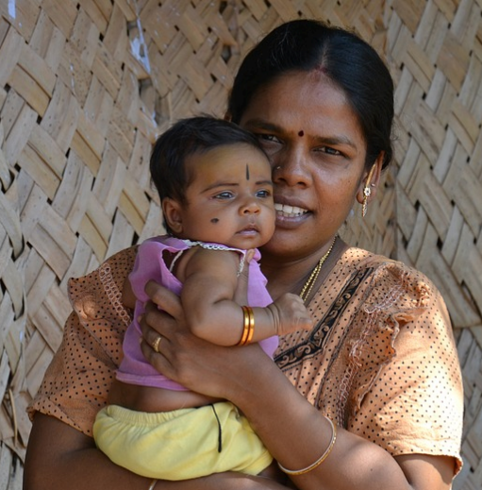
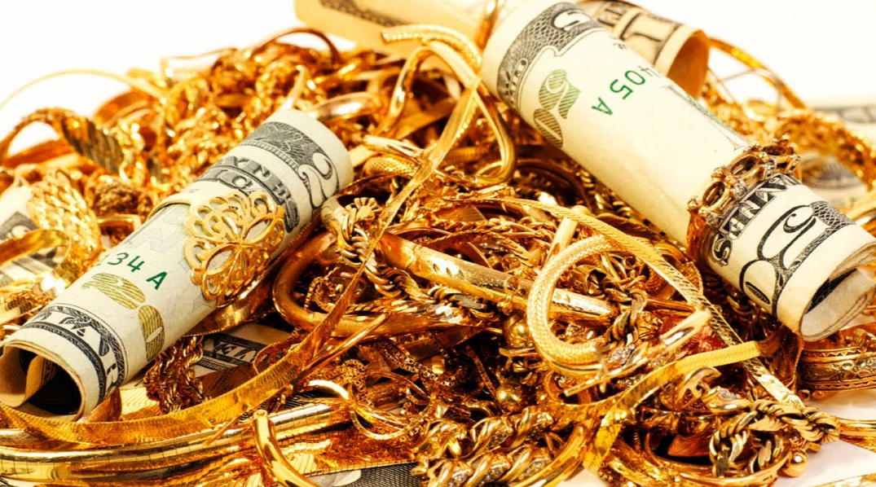
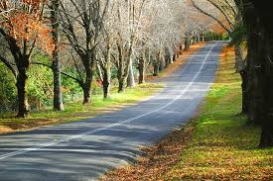
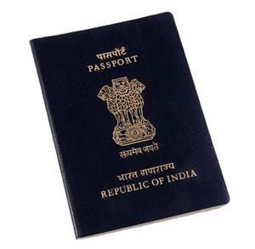
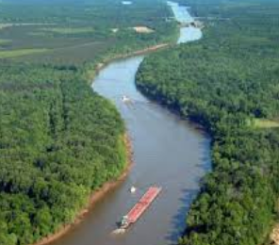
Puzzle #9
4/7
5/9
1/10
2/6
6/11
8/9

Slide 10

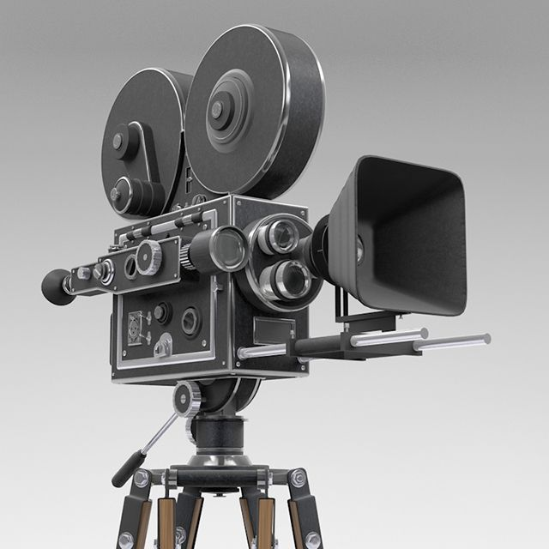
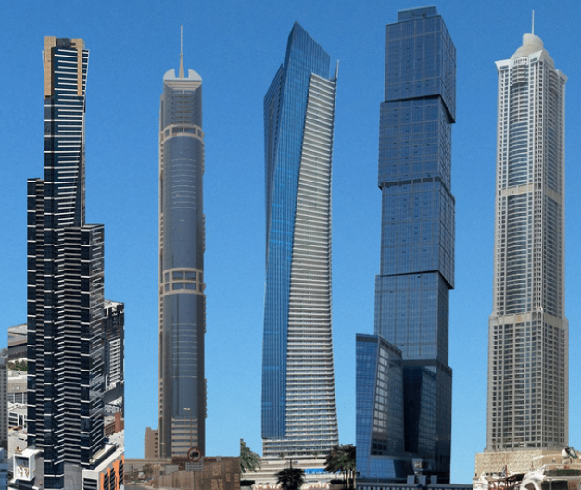
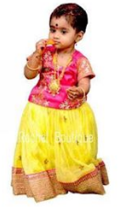
Puzzle #10
7/11
4/9
5/16
5/13
6/7
6/7

Slide 11
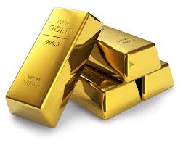
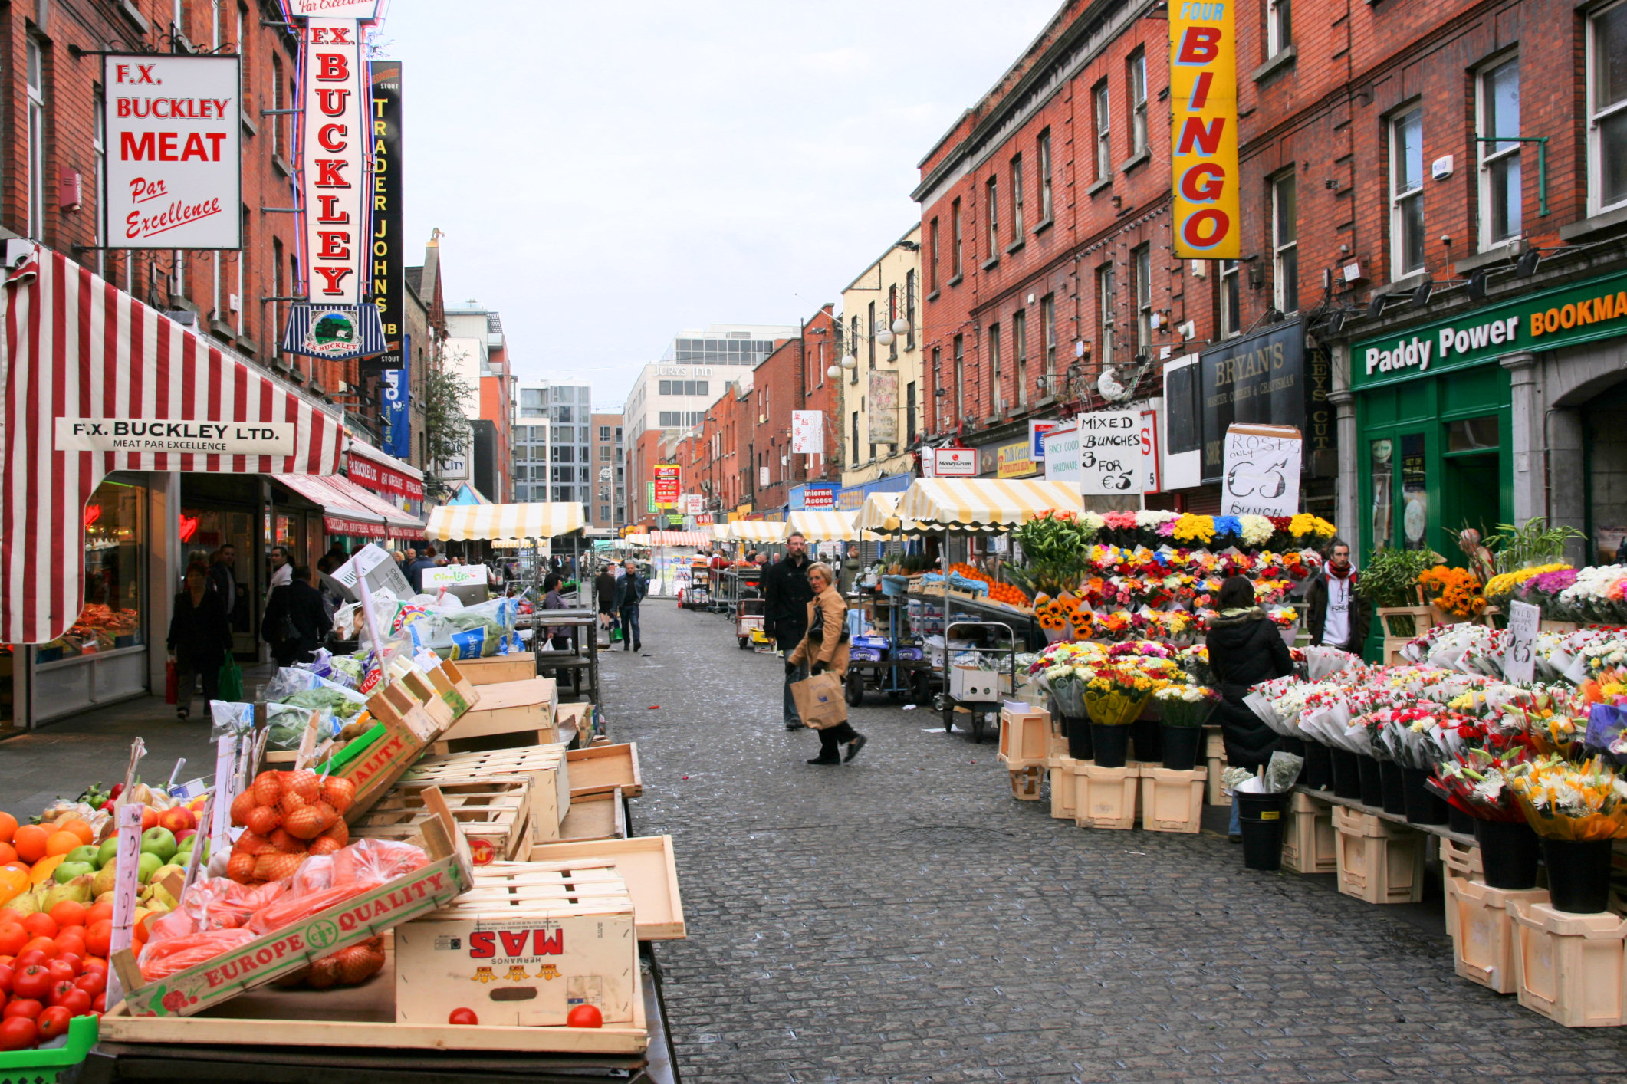
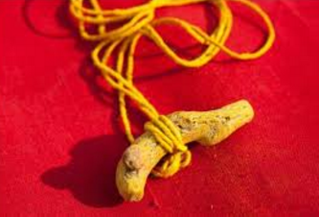
Puzzle #11
5/10
8/12
3/10
1/5
4/5
10/11

Slide 12
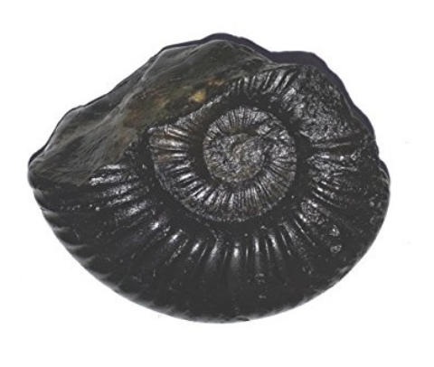
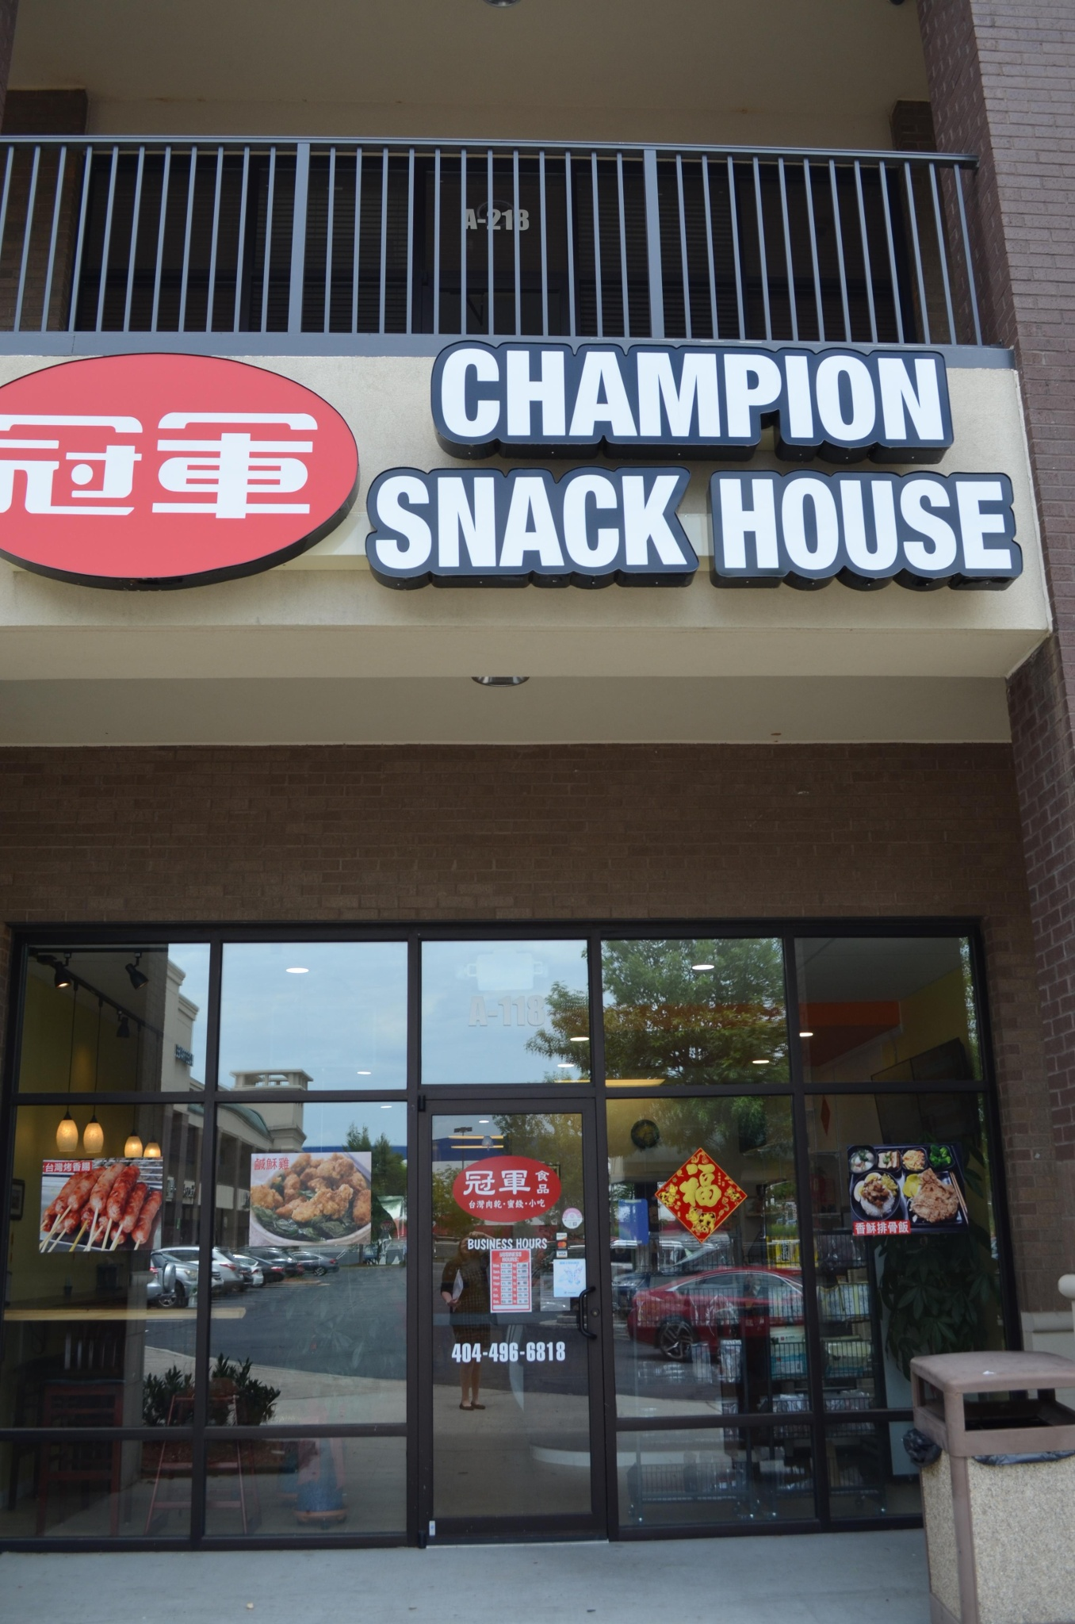
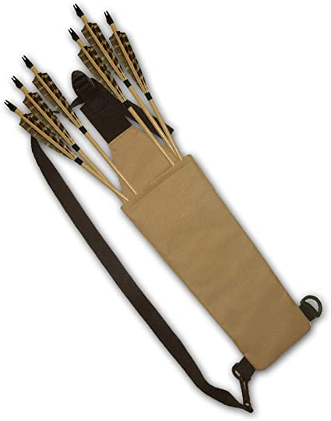
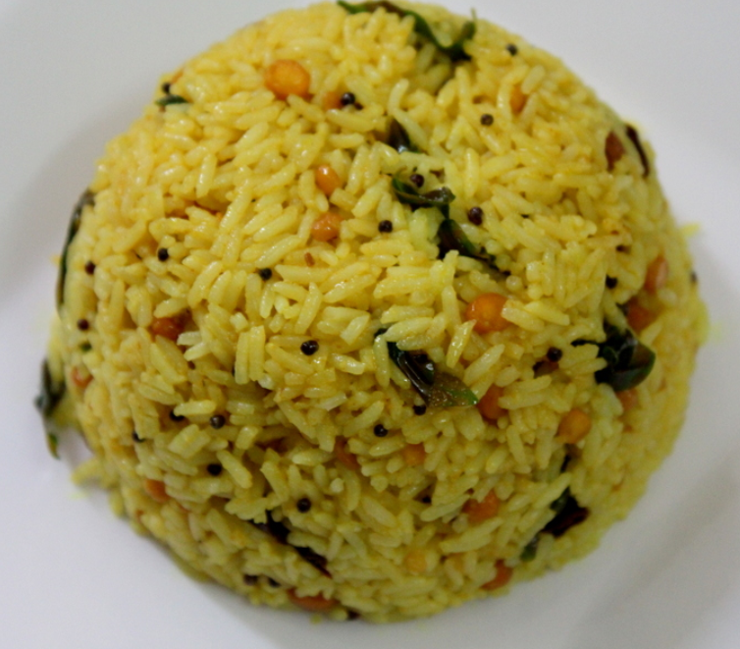
Puzzle #12
1/10
10/12
4/10
3/8
3/6
9/10

Slide 13
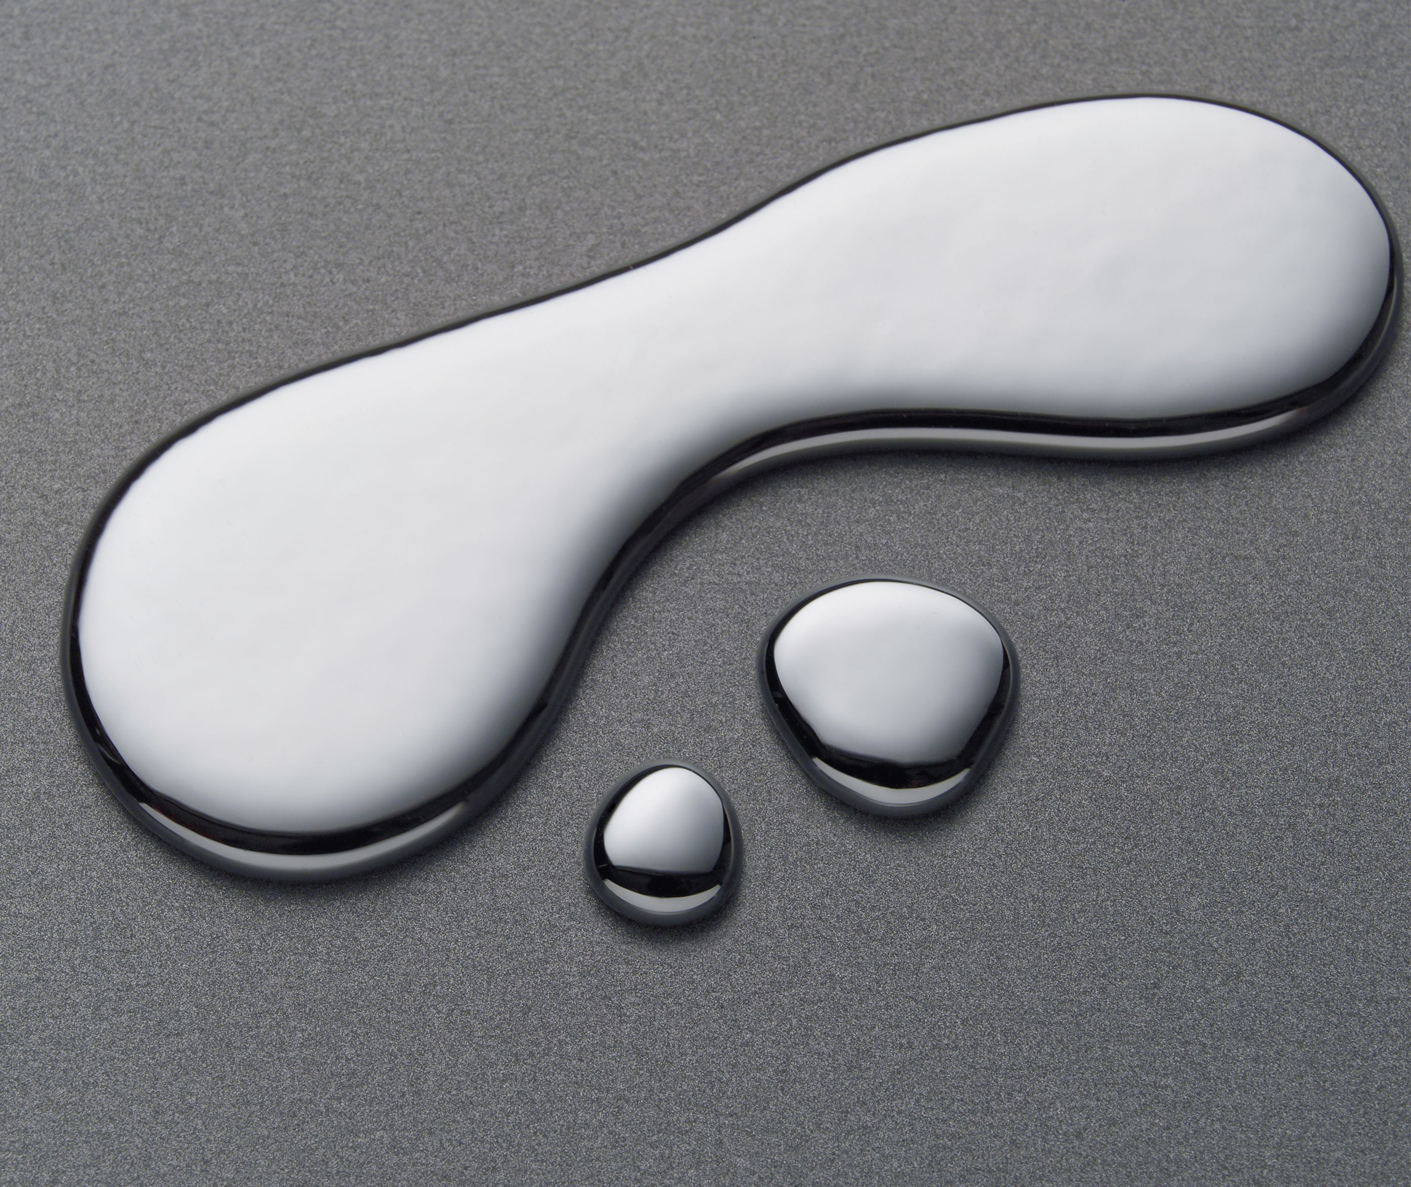

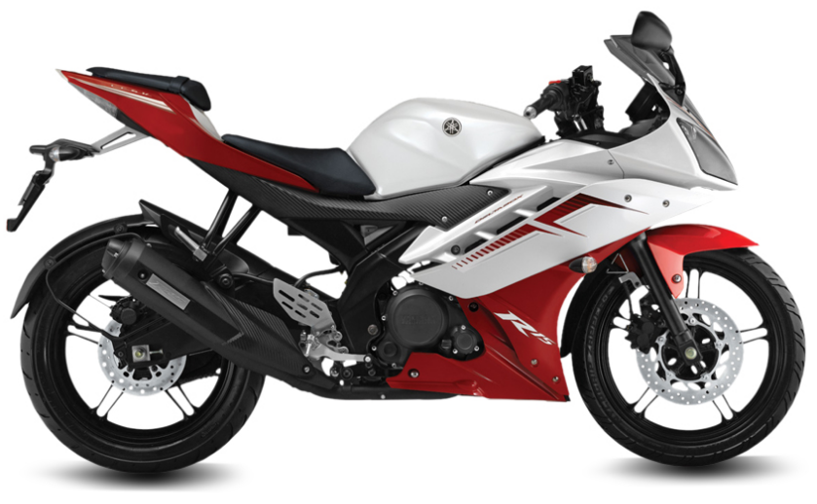

Puzzle #13
1/6
2/11
6/11
11/14
3/9
1/6

Slide 14

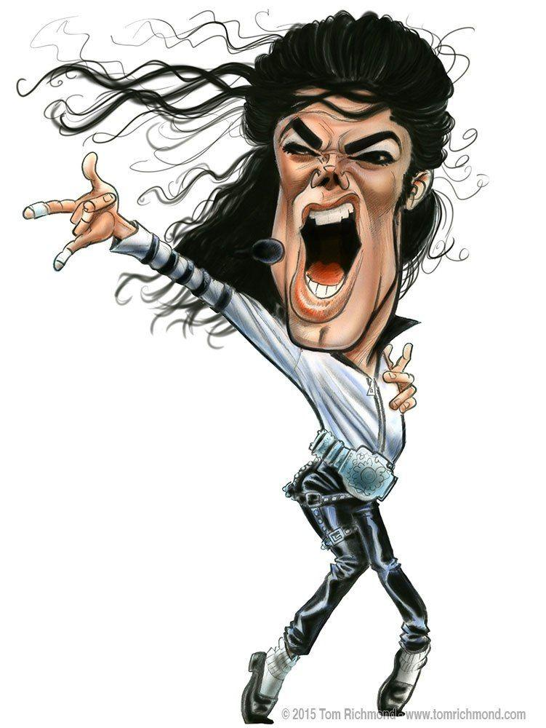
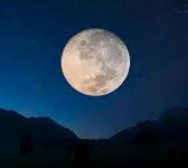
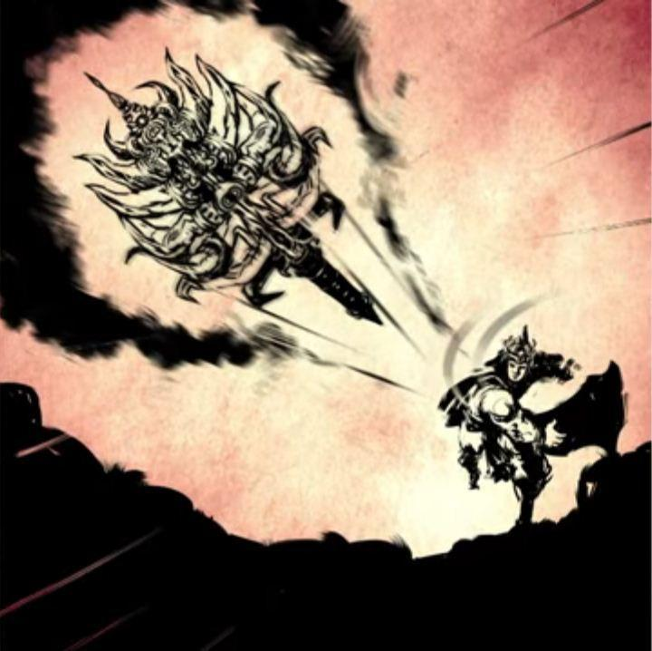
Puzzle #14
5/10
3/8
1/13
1/12
5/13
8/9

Slide 15
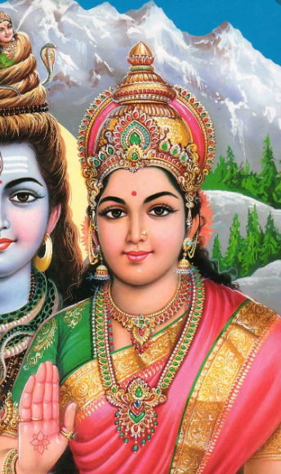
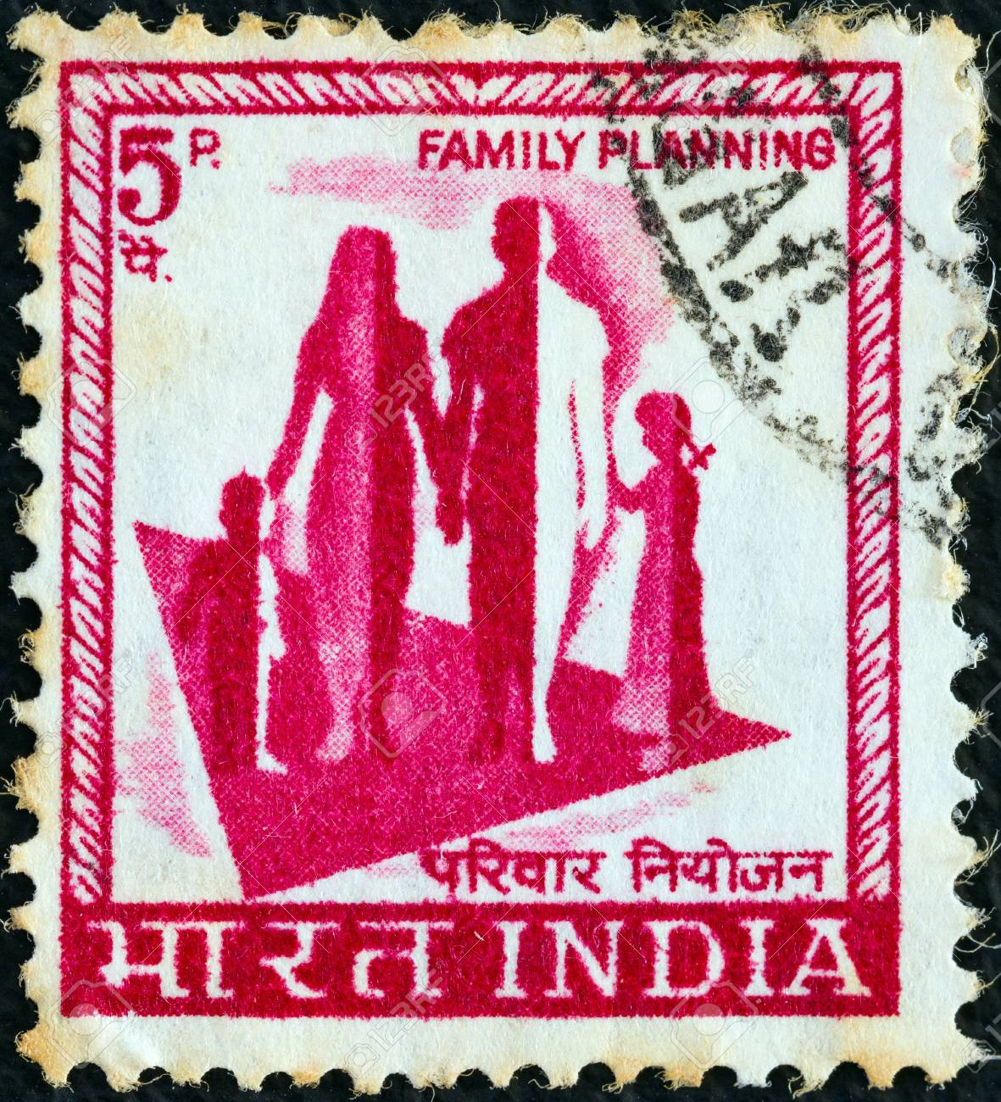

Puzzle #15
4/7
6/10
5/8
1/4
14/14
15/16

Slide 16


Puzzle #16
1/10
2/9
1/11
11/14
3/4
2/4

Slide 17


Puzzle #17
4/7
5/14
7/12
4/8
9/10
1/6

Slide 18



Puzzle #18
4/7
2/11
7/12
9/12
6/6
8/9

Slide 19



Puzzle #19
5/11
9/13
6/11
3/6
6/12
4/5

Slide 20


Puzzle #20
5/11
9/13
2/8
4/7
6/8
3/4

